Slide 1

Mini Project—Movie analysis and recommendation
Group 1
Hu tianrun & nhat hoang
----Presented by Hu Tianrun

Slide 2
Outline
Introduction to the question on the data set
Data extraction, curation, preparation and cleaning to suit the problem
Exploratory data analysis/visualization to gather relevant insights
Illustration to the machine learning technique applied in this project.

Slide 3
1. Introduction to the question

Slide 4
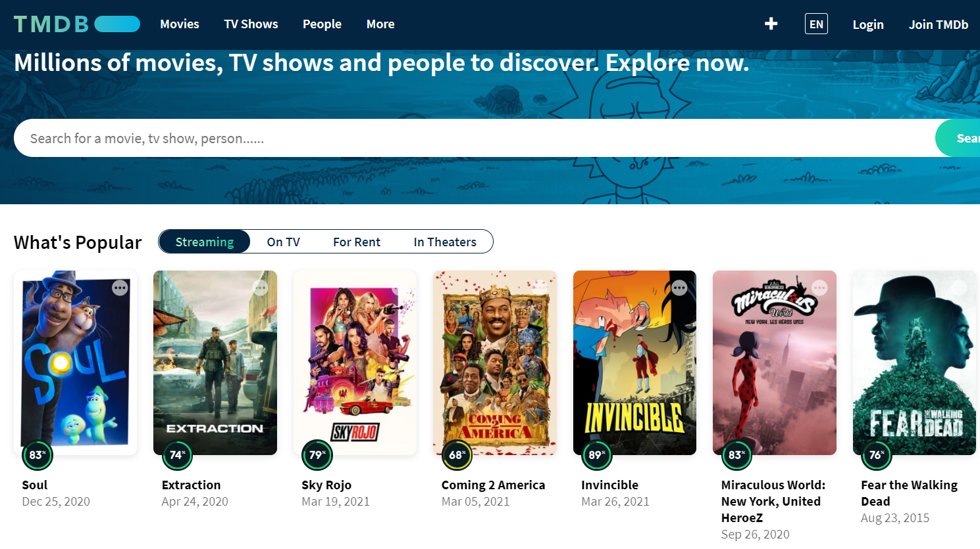

Slide 5
We choose to analyze the movie data set due to both of us are interested in movies.
There are two main perspectives:
1. If we want to make a movie, which aspect should we pay more attention? (the more we input, the more we gain?)
2. If we want to watch a movie, which movie satisfy our test most? (the recommendation system)

Slide 6
2. Data extraction, curation, preparation and cleaning to suit the problem

Slide 7
Variables
id: ID of a movie on TMDB.
movieId: ID of a movie on MovieLens.
title: The title of the movie.
genres : Genres tag of the movie
overview: A brief introduction of the movie. It is interesting to read.
original_language: The original language of the movie.
budget : How much money has been put to make the movie.
popularity: It shows how popular the movie is.
production_companies: Which companies produced this movie.
production_countries: In which the movie is produced.
revenue: The revenue of the movie.
runtime: How long the movie is.
vote_average: The average vote this movie got.
vote_count: How many people vote for this movie.

Slide 8
How many languages are there in the movies
Number of Languages : 38
en 8246 ja 451
es 311 fr 189
ko 105 zh 79
cn 68 it 58
de 53 ru 47
pt 21 hi 20
no 19 da 19
sv 15 th 10
pl 10 nl 10
id 8 tr 5
te 5 ar 3
eu 3 cs 3
uk 3 fa 2
sr 2 he 2
tl 2 fi 2
el 2 ro 2
is 1 hu 1
ms 1 ta 1
nb 1 la 1

Slide 9
How many companies and countries are involved into making these movies?
9725 companies
106 countries

Slide 10
3. Exploratory data analysis/visualization to gather relevant insights

Slide 11
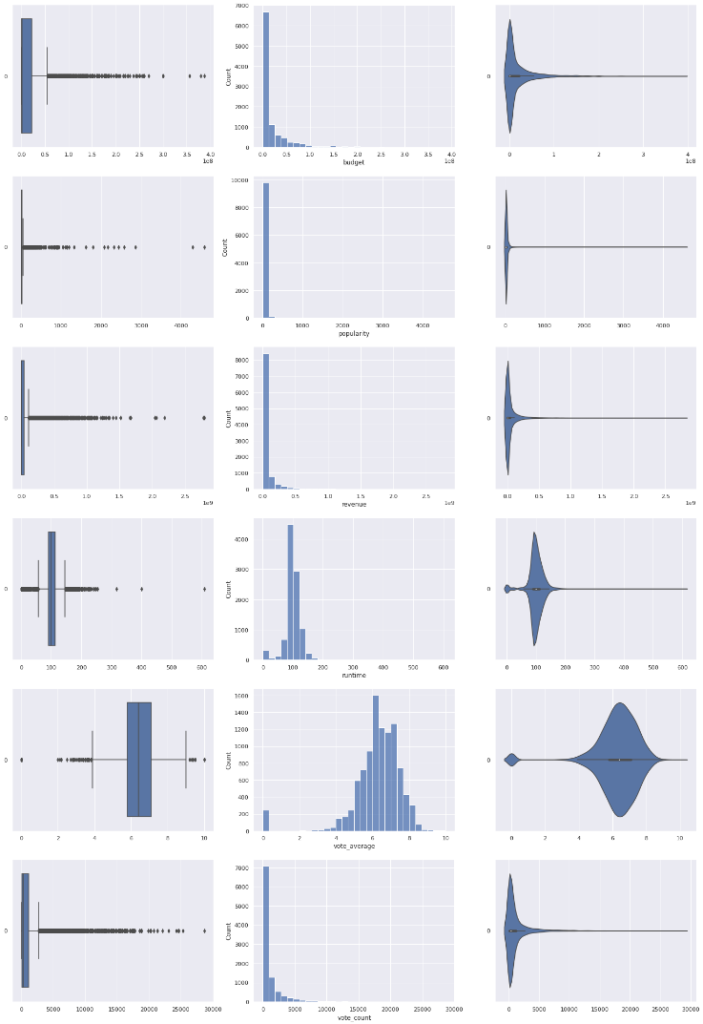
Primary analysis
Firstly, we found that some movies (over 25%) have no budget.
For the popularity, it is very different among movies. The most popular movie has popularity of 145 while most of the movies (over 75%) have popularity less than 30. (It is not easy to make a popular movie)
The revenues distribute not uniformly as well.
For the runtime, there are some movie whose runtime is 0 because they are initially a Null value; there are also movies with runtime very high. However, there are many of them have pretty high popularity.
The vote average is quite good. There are some movie got 0 which is weird because they don’t have any vote. However, except for them, the distribution is almost a bell line.

Slide 12
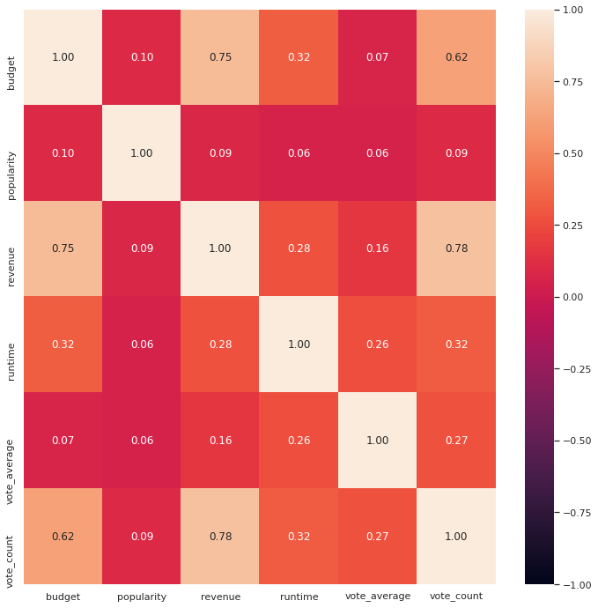
Relationship between variables
The relationship coefficient between budget and popularity is 0.10, it means that for an "expensive" movie, people might not like it.
The relationship coefficient between popularity and revenue is not high, which is 0.09, it means "popularity" does not always bring you high revenue.
The relationship coefficient between budget and revenue is 0.75. There is a linear relation between them. Therefore, in general, it can be said that the more you put in, the more you gain.
Meanwhile, runtime has a relatively low relationship coefficient with all other variables. This tells us runtime is not very important to both audience and the producer. A good movie does not depend on its running time!
Interestingly, there is a positive relation between vote_count and budget, vote_count, revenue. We think vote_count shows how much attention the audiences paid to the movie. Thus the relationship shows that the more "expensive" the movie is, the more people care about it. However, vote_average has no significant relationship with any of the variables.

Slide 13
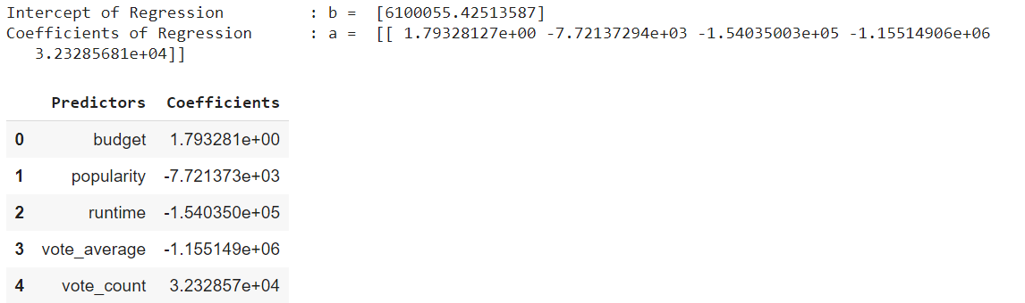
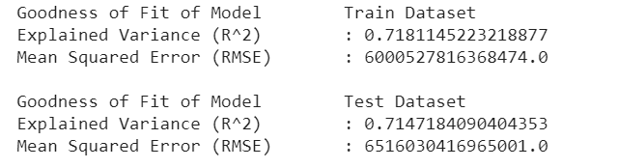
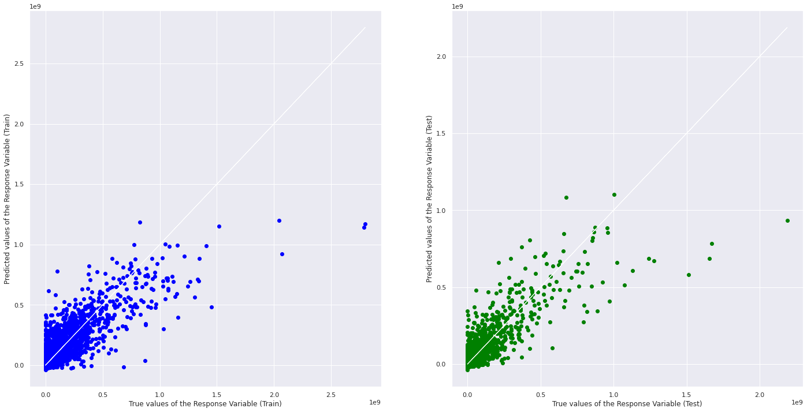
Regression

Slide 14
Primary movie recommendation without machine learning

Slide 15
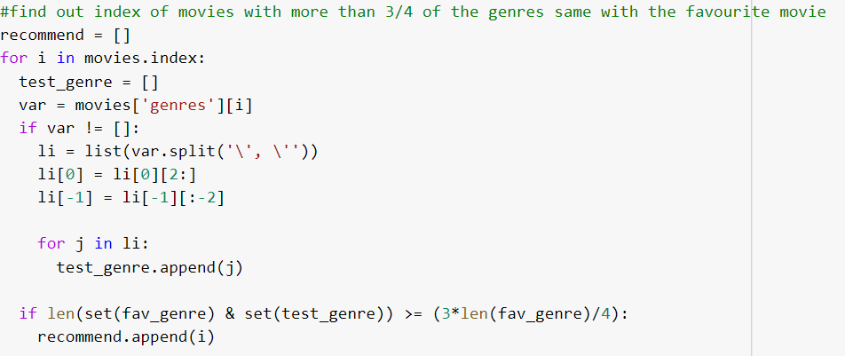
Firstly, enter a movie you like most.
This code will find out movies which has more than ¾ genres same with the movie you like.

Slide 16
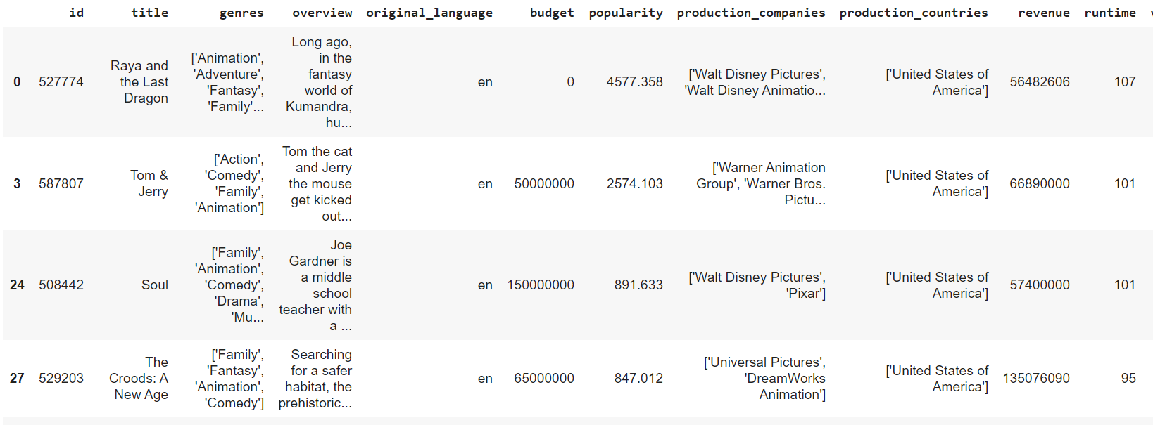
Then, it will provide a new dataset without machine learning.
This recommendation is very rough. It only consider the genres. The better approach will use machine learning tools

Slide 17
4. Illustration to the machine learning technique applied in this project.(machine learning)

Slide 18
Approach I: Content-Based Recommendation System

Slide 19
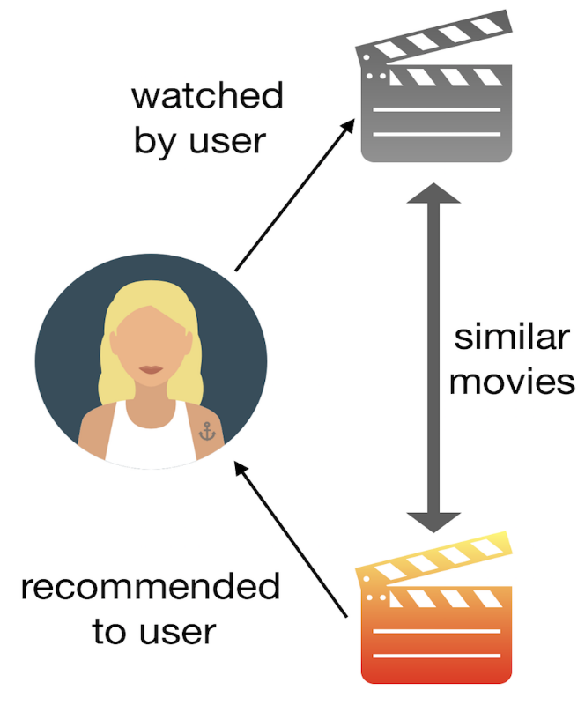
Background
The Content-Based Recommender (or CB recommender) relies on the similarity of the items. The basic idea is if you like an item, then you will also like a “similar” item.
A CB recommender works with data that the user provides. Based on that data, a user profile is generated, which is then used to make suggestions to the user.
As the user provides more inputs or takes actions on the recommendations, the engine becomes more accurate.

Slide 20
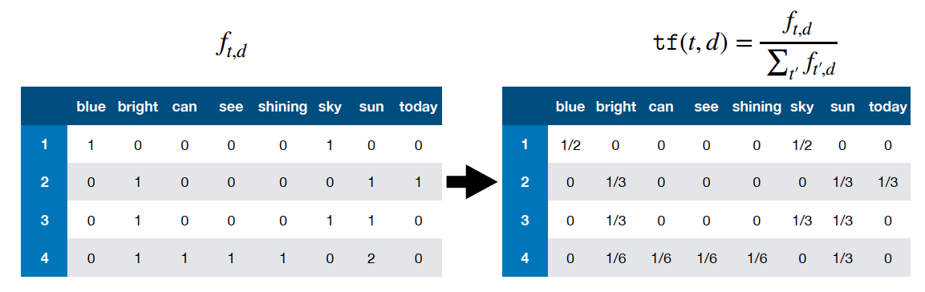
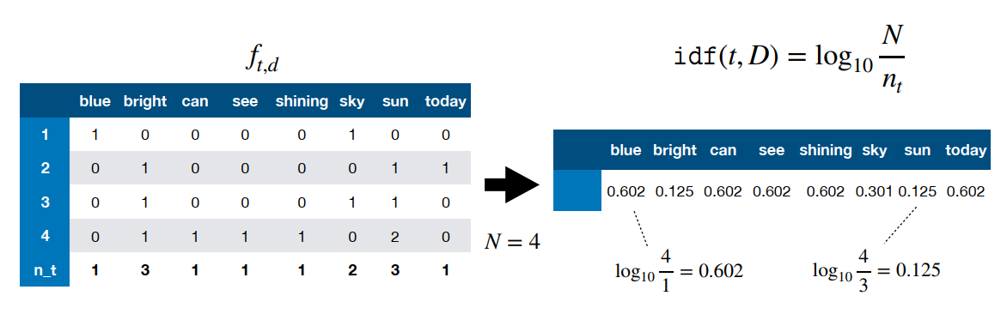
Mathematical Concepts Used
Term Frequency (TF) and Inverse Document Frequency (IDF)
TF is simply the frequency of a word in a document
IDF is the inverse of the document frequency among the whole corpus of documents

Slide 21
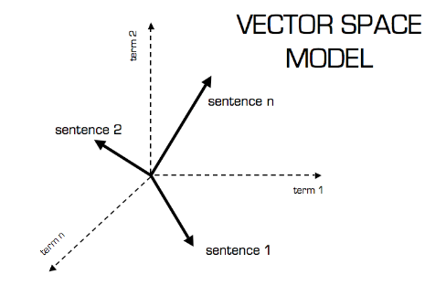
Mathematical Concepts Used
Vector Space Model
In this model, each item is stored as a vector of its attributes (which are also vectors) in an n-dimensional space.
The angles between the vectors are calculated to determine the similarity between the vectors.

Slide 22
Methodology
We consider two features to test our content-based recommenders: the overview of the movie’s plot and the genres of the movie.
Use TfidfVectorizer from sklearn library to get a matrix of n x m, where n is number of movies and m is number of words after calculating TF-IDF.
Use linear_kernel to from sklearn library to calculate the cosine similarity between vectors in the matrix.
Recommend the top 10 movies with the highest similarity to the input movie.

Slide 23
Recommendations by ‘overview’ feature
Avatar | Toy Story | The Matrix
The Painting Sellers | Toy Story 3 | Holy Matrimony
Onnenpeli | Toy Story 2 | 11 x 14
The Lumière Brothers’ First Films | Child's Play 2 | Pillow of Death
Flatfoot in Egypt | Group Sex | Un Flic
Workers Leaving the Lumière Factory | The 40 Year Old Virgin | Death of a Cyclist
The Way South | Andy Hardy's Blonde Trouble | Richard III
Passion in the Desert | Malice | Rogue Cop
My Piece of the Pie | Small Fry | Blood Out
Chronicle of the Years of Fire | The Gang's All Here | Evelyn Prentice
My Way | The First $20 Million Is Always the Hardest | Radio On

Slide 24
Recommendations by ‘genres’ feature
Avatar | Toy Story | The Matrix
Heidi Fleiss: Hollywood Madam | The Pirates! In an Adventure with Scientists! | The Strange Case of the End of Civilisation as We Know
Catwalk | Balto | Murder à la Mod
From the Journals of Jean Seberg | The Land Before Time III: The Time of the Great Giving | Frogs for Snakes
Crumb | The Black Cauldron | Cecil B. Demented
The Show | The Land Before Time | Crimewave
Unzipped | The Wild Thornberrys Movie | The Ferpect Crime
Hoop Dreams | Pinocchio and the Emperor of the Night | The Octopus
The Wonderful, Horrible Life of Leni Riefenstahl | The Adventures of Mark Twain | The Liability
Frank and Ollie | The Pebble and the Penguin | Caprice
Brother Minister: The Assassination of Malcolm X | Lego Batman: The Movie - DC Super Heroes Unite | Shoot 'Em Up

Slide 25
Observation
The recommendations using ‘overview’ and ‘genres’ are different.
For movie ‘Toy Story’, which is a movie for kids, the overview-based system recommends ‘The Group Sex’, it is not suitable for children. Thus the genres-based seems better than the overview one.
The recommended movies may not be popular.

Slide 26
Discussion of CB Approach
Advantages
Disadvantages
The model does not need any data about other users, since the recommendations are specific to this user.
The model can capture the specific interests of a user, and can recommend niche items that may not be popular but still relevant to the user profile.
This technique requires a lot of domain knowledge because the feature of the items are hand-engineered to some extent.
It will never recommend items which the user has not liked. It is a very narrow way of building an engine. For example, if the user liked an action movie, the system would never recommend other genres.

Slide 27
Approach II: Collaborative Filtering Recommendation System

Slide 28
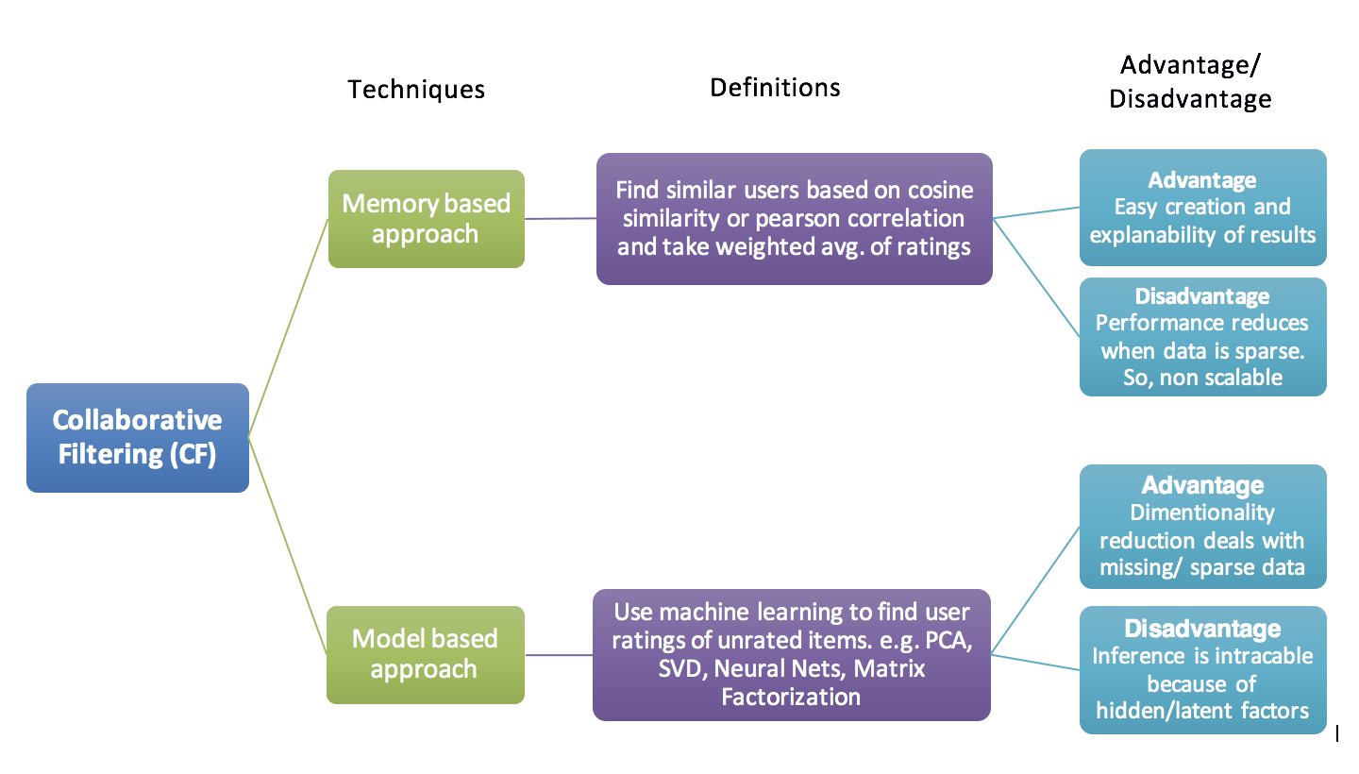
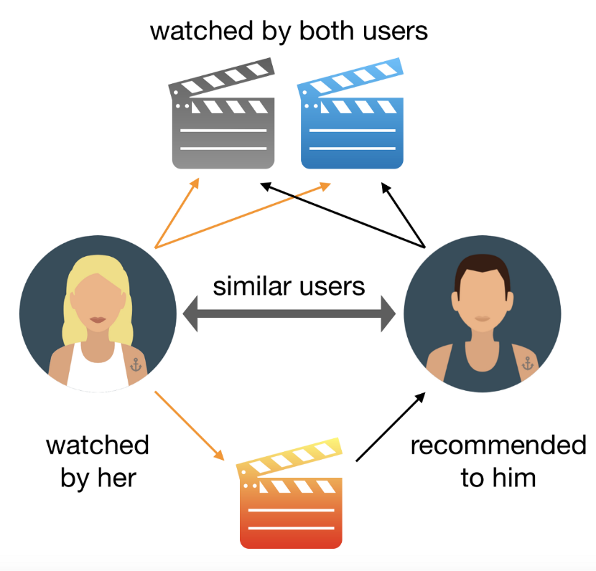
Background
The Collaborative Filtering Recommender is based on the past behavior, the similarity in preferences, tastes and choices of two users.
There are two major techniques: memory-based and model-based.
We will do the model-based approach by using SVD model from Surprise library, which is a Python scikit for recommender systems.

Slide 29
Mathematical Concepts Used
Matrix Factorization:
A way to generate latent features when multiplying two different kinds of entities.
With the input of users’ ratings, we can predict how the users would rate other items so they can get recommendations based on that prediction.
The idea of this is to factorize a big rating matrix into two smaller matrices: user matrix and item matrix based on k features of movies (genre, actors, plot,…). We use SVD model to find the best matrices as possible.
The rating matrix now is represented as a dot product of user matrix and item matrix.

Slide 30
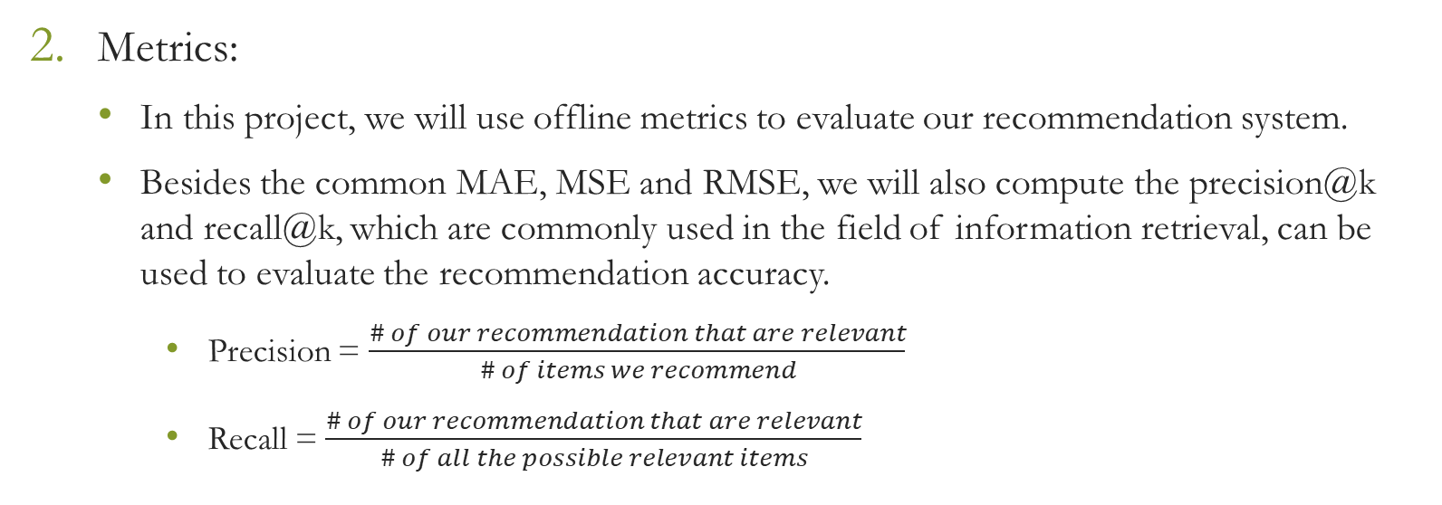
Mathematical Concepts Used
Metrics:
In this project, we will use offline metrics to evaluate our recommendation system.
Besides the common MAE, MSE and RMSE, we will also compute the precision@k and recall@k, which are commonly used in the field of information retrieval, can be used to evaluate the recommendation accuracy.
Precision = $\frac{\# of our recommendation that are relevant}{\# of items we recommend}$
Recall = $\frac{\# of our recommendation that are relevant}{\# of all the possible relevant items}$

Slide 31
Methodology
Grid search is a tuning technique that attempts to compute the optimum values of hyperparameters.
To train our SVD model with the best parameters, we first split the dataset into two smaller sets A and B. A is used for parameter tuning using grid search, and B is used for unbiased estimation.
Use grid search for the whole set A to get a model with optimum hyperparameters.
Then use the optimum model to get estimation on set B and evaluate by using offline metrics.

Slide 32
Results
We got RMSE = 0.942 on our set B, which is not very good,
 | MAE | MSE | RMSE
Biased accuracy on set A | 0.5808 | 0.5713 | 0.7559
Unbiased accuracy on set B | 0.7282 | 0.8873 | 0.9420

Slide 33
Approach III: Hybrid Recommendation System

Slide 34
Background
Hybrid recommender is system combine two or more recommendation strategies in different ways to benefit their complementary advantages.
In our project, we combine our first two systems, the content-based and model-based, to build a hybrid one.

Slide 35
Methodology
We use the content-based system to get the top 50 movies with the highest similar score to the given movie.
From those 50 movies, we use the model-based system to predict how the given user would rate them.
In 50 movies, we recommend the top 10 movies with the highest estimated ratings to the user.

Slide 36
Recommendations for User 10
Avatar | Toy Story | The Matrix
The Wonderful, Horrible Life of Leni Riefenstahl | The Black Stallion | The Thin Man
American Dream | Frozen | After then Thin Man
Paris is Burning | The Pirates! In an Adventure with Scientists! | Shadow of the Thin Man
Hands on a Hardbody: The Documentary | Oblivion Island: Haruka and the Magic Mirror | Murder by Death
Maya Lin: A Strong Clear Vision | Treasure Island | A Shot in the Dark
Fast, Cheap & Out of Control | Pinocchio and the Emperor of the Night | It’s a Wonderful World
When We Were Kings | Kaena: The Prophecy | The Perfect Crime
The Celluloid Closer | The Incredible Journey | Deathtrap
Microcosmos | In Search of the Castaways | The Strange Case of the End of Civilization as We Know
Crumb | Legend of the Guardians: The Owls of Ga’Hoole | Gumshoe

Slide 37
References:
[1] James Le (2018) The 4 Recommendation Engines That Can Predict Your Movie Tastes
[2] Darla M, How TF-IDF Works
[3] Cesarsouza (2010) Kernel Functions for Machine Learning Applications
[3] Surprise library documentary FAQ — Surprise 1 documentation
[4] P. H. Aditya, I. Budi, Q. Munajat (2016) A Comparative Analysis of Memory-based and Model-based Collaborative Filtering on the Implementation of Recommender System for E-commerce in Indonesia: A Case Study PT X
[5] Farhad Malik (2020) What Is Grid Search?. Explaining How To Obtain Optimal Hyperparameter Values
[6] Maher Malaeb (2017) Recall and Precision at k for Recommender Systems
[7] Sachin Parbhu Thandapani (2019) Recommendation Systems: Collaborative Filtering using Matrix Factorization
[8] Introduction | Recommendation Systems | Google Developers

